Slide 1

Domain: MATLAB
Technology: Artificial Intelligence
Fingerprint Identification with Fusion of Gabor and Minutiae Features Using BPNN Classifier
<Name of the Students>

Slide 2
Index
Abstract
Introduction
Literature review
Existing Method
Drawbacks
Proposed method
Advantages
Applications
Hardware and Software Requirements
Results
Conclusion
References

Slide 3
Abstract:
This study presents an innovative approach to fingerprint identification by leveraging the fusion of Gabor and Minutiae features, employing a Backpropagation Neural Network (BPNN) classifier for accurate categorization. The process involves initial handling of a fingerprint image dataset, including crucial pre-processing steps such as resizing images and implementing morphological operations like dilation, erosion, and opening. Subsequently, Gabor features and minutiae extraction are performed, followed by the fusion of these features to create a comprehensive representation. To address dimensionality concerns, Principal Component Analysis (PCA) is applied. The dataset, comprising the fused features and corresponding labels, is then loaded for the final step - classification using a BPNN. The network is configured for feed-forward backpropagation, distinguishing fingerprint patterns into categories such as arch, left loop, right loop, tented, and whorl. The evaluation metric used to measure the success of the classification process is accuracy. This approach aims to enhance fingerprint recognition by combining distinctive Gabor and minutiae features, ultimately achieving a more robust and precise identification system through the utilization of neural network-based classification.
Keywords: Finger print images dataset, BPNN, Deep learning techniques, PCA, classification and pre-processing, Minutiae features.

Slide 4
Introduction:
This study focuses on advancing fingerprint identification through the application of Convolutional Neural Networks (CNNs), a prominent deep learning technique. Fingerprint identification plays a pivotal role in various domains such as law enforcement, access control, and immigration. Traditional methods of fingerprint analysis have relied on manual interpretation and feature extraction, which can be time-consuming and prone to error. By employing CNNs, which are capable of learning intricate patterns and features directly from raw data, this research seeks to enhance the accuracy and efficiency of fingerprint identification. The classification task involves categorizing fingerprints into distinct patterns, including Arch, Left Loop, Right Loop, Tented, and Whorl. CNNs offer significant advantages in handling complex data structures like fingerprint images, making them well-suited for this classification task. The utilization of CNNs in fingerprint identification holds promise for improving biometric security systems, streamlining identification processes, and enhancing overall security measures.

Slide 5
Literature Review:
S. No | Journal Type with year | Authors | Title | Outcomes
1 | Neural Comput Appl 2013;(23):1605–10. | Hasan H, Abdul-Kareem S. | Fingerprint image enhancement and recognition algorithms: a survey | Survey of algorithms for enhancing and recognizing fingerprint images.
2 | Fut Gener Comput Syst 2020; 110:758–71. | Win KN, Li K, Chen J, Viger PF, Li K | Fingerprint classification and identification algorithms for criminal investigation: a survey. | Survey explores fingerprint algorithms for crime scene analysis and identification.
3 | Sensors 2018;18: 1008. | AlShehri H, Hussain M, AboAlSamh H, AlZuair M | A large-scale study of fingerprint matching systems for sensor interoperability problem | Study explores fingerprint systems for sensor compatibility in large-scale operations.

Slide 6
Literature Review:
S. No | Journal Type with year | Authors | Title | Outcomes
1 | J Eng (JOE) 2012;1(3):40–8. | Shemmary ENAAl. | Classification of fingerprint images using neural networks technique. | Fingerprint image classification using neural networks for identification.
2 | IEEE Trans Inform Forens Secur 2011;6(1):59–69. | Leung KC, Leung CH | Improvement of fingerprint retrieval by a statistical classifier. | Enhancing fingerprint matching with advanced statistical analysis.
3 | Sensors 2020; 20:4473. | Wan GC, Li MM, Xu H, Kang WH, Rui JW, Tong MS. | X-Finger-net: pixel-wise segmentation method for partially defective fingerprint based on attention gates and U-net. | X-Finger-net: Accurate pixel segmentation for flawed fingerprints.

Slide 7
Existing Method:
Input Image
Image Resize
Pre - Processing
Morphological Operations
Dilate Image
Erode Image
Opening of Image
PCA
Convolution Neural Network
Gabor Features
Layers
Training Options
Block Diagram of Existing Method
Classification
Classification
Arch
Left Loop
Right Loop
Tented
Whorl
Accuracy

Slide 8
Existing Method:
The Existing Method involves leveraging Gabor features and a Convolutional Neural Network (CNN) classifier to enhance fingerprint identification. Initially, the fingerprint images undergo preprocessing steps, including resizing, morphological operations, and extraction of Gabor phase and texture features. These preprocessing techniques aim to standardize image sizes, enhance feature extraction, and improve the quality of fingerprint representations. Principal Component Analysis (PCA) is then utilized for dimensionality reduction, optimizing feature selection and improving computational efficiency. Subsequently, the CNN classifier, powered by deep learning techniques, is employed for classification. The CNN model is trained using labelled data to recognize various fingerprint patterns, such as Arch, Left Loop, Right Loop, Tented, and Whorl. Through the training process, the CNN learns to differentiate between different fingerprint patterns based on the extracted Gabor features. The classification accuracy of the system is evaluated to gauge its effectiveness in accurately categorizing fingerprints into their respective patterns. By integrating Gabor features with CNN classification, this methodology aims to achieve heightened accuracy in fingerprint identification, thereby advancing the capabilities of biometric security systems.

Slide 9
Disadvantages in Existing Method:
Using a CNN for fingerprint ID needs lots of computer time.
Neural networks need lots of data for good training, making it tough for fingerprint datasets with various patterns.
CNNs are like black boxes, hard to understand how they work.

Slide 10
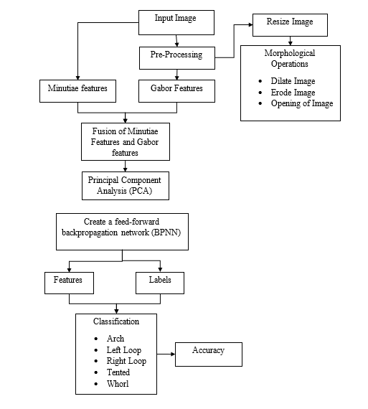
Proposed Method:
Block Diagram of Proposed Method

Slide 11
Proposed Method:
The proposed methodology for fingerprint identification involves several sequential steps to enhance accuracy through the fusion of Gabor and Minutiae features using a Backpropagation Neural Network (BPNN) classifier. Initially, a dataset of fingerprint images is collected, followed by a preprocessing stage. This includes resizing images and applying morphological operations, such as dilation, erosion, and opening, to improve the quality and clarity of the features. Gabor features, capturing texture information, and minutiae extraction, identifying specific ridge characteristics, are then extracted. The fusion of Gabor and minutiae features aims to create a comprehensive representation of fingerprint patterns. To manage the high-dimensional feature space, Principal Component Analysis (PCA) is applied for dimensionality reduction. Subsequently, the reduced feature set along with their corresponding labels are loaded for the final classification step. A feed-forward BPNN is created to train the model to classify fingerprints into distinct categories, such as arches, left loops, right loops, tented arches, and whorls. The accuracy of the classification results is evaluated, demonstrating the effectiveness of the proposed methodology in accurately identifying and categorizing various fingerprint patterns.

Slide 12
Advantages of Proposed Method:
Combining Gabor and Minutiae features boosts fingerprint system accuracy, securing access.
BPPN learns well, helps classify, makes fingerprint ID smoother, more effective.
System uses BPPN and Minutiae, works well for all fingerprint types.
Minutiae features enable unique and precise fingerprint identification.

Slide 13
Applications of Proposed Method:
Biometric Security.
Fingerprint help police catch criminals and track suspects in investigations.
Fingerprint systems help border control verify travelers and spot fake documents.
Fingerprint security safeguards banking, blocks unauthorized access to accounts and data.

Slide 14
Hardware & Software Requirements:
Software: Matlab R2020a or above
Hardware:
Operating Systems:
• Windows 10
• Windows 7 Service Pack 1
• Windows Server 2019
• Windows Server 2016
Processors:
Minimum: Any Intel or AMD x86-64 processor
Recommended: Any Intel or AMD x86-64 processor with four logical cores and AVX2 instruction set support
Disk:
Minimum: 2.9 GB of HDD space for MATLAB only, 5-8 GB for a typical installation
Recommended: An SSD is recommended A full installation of all MathWorks products may take up to 29 GB of disk space
RAM:
Minimum: 4 GB
Recommended: 8 GB

Slide 15
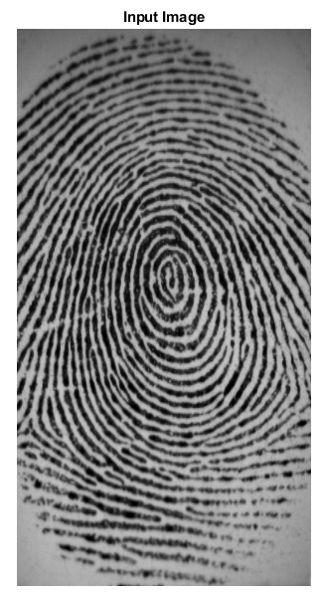
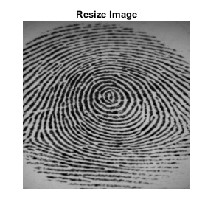
Results
Fig: Resize Image
Fig: Input Image

Slide 16
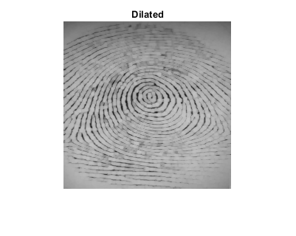
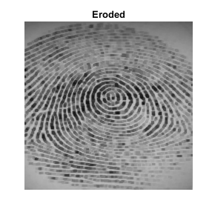
Results
Fig: Dilated Image
Fig: Erode Image

Slide 17
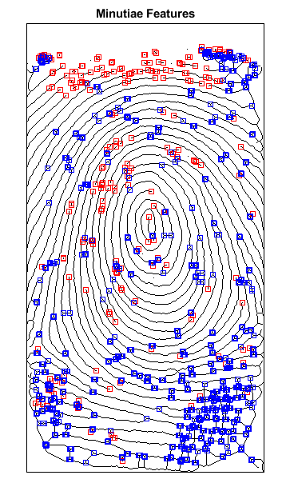
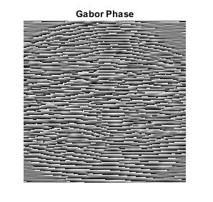
Results
Fig: Gabor Phase Image
Fig: Minutiae Features

Slide 18
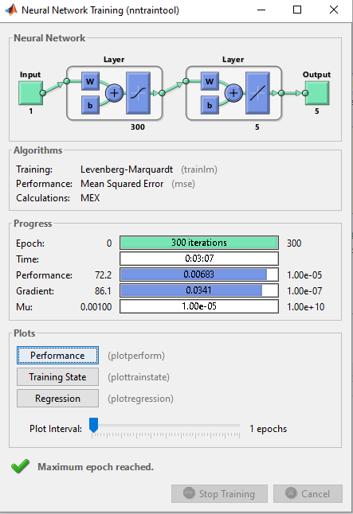
Results
Fig: Training Process

Slide 19
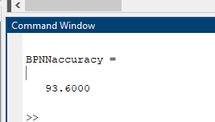
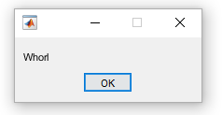
Results
Fig: Accuracy
Fig: Final Output

Slide 20
Results
S. No | Existing Method | Proposed Method
1 | 78 | 86.4
2 | 78 | 93.6
3 | 78 | 90
4 | 78 | 93.6
5 | 78 | 90
Fig: Difference Between Existing Method and Proposed Method
Fig: Comparison Graph

Slide 21
Conclusion
In conclusion, the fusion of Gabor and Minutiae features coupled with a BPNN classifier presents a robust approach to fingerprint identification. Through the systematic process involving preprocessing, feature extraction, fusion, dimensionality reduction, and classification, the system achieves accurate recognition of various fingerprint patterns including arches, loops, tented arches, and whorls. The application of morphological operations, PCA for dimensionality reduction, and the utilization of a BPNN classifier contribute to the system's reliability and efficiency. This methodology demonstrates promising results in enhancing the accuracy of biometric authentication systems, thereby ensuring secure access control. Moving forward, further research could explore optimizations to streamline the process and potentially integrate additional features or algorithms to enhance the system's performance in real-world applications.

Slide 22
References:
[1] Hasan H, Abdul-Kareem S. Fingerprint image enhancement and recognition algorithms: a survey. Neural Comput Appl 2013;(23):1605–10.
[2] Win KN, Li K, Chen J, Viger PF, Li K. Fingerprint classification and identification algorithms for criminal investigation: a survey. Fut Gener Comput Syst 2020; 110:758–71.
[3] Nazarkevych M, Riznyk O, Samotyy V, Dzelendzyak U. Detection of regularities in the parameters of the Ateb-Gabor method for biometric image filtration. East Eur J Enterp Technol 2019;1(2–97):57–65.

Slide 23
References:
[4] Shemmary ENAAl. Classification of fingerprint images using neural networks technique. J Eng (JOE) 2012;1(3):40–8.
[5] Leung KC, Leung CH. Improvement of fingerprint retrieval by a statistical classifier. IEEE Trans Inform Forens Secur 2011;6(1):59–69.
[6] Wan GC, Li MM, Xu H, Kang WH, Rui JW, Tong MS. XFinger-net: pixel-wise segmentation method for partially defective fingerprint based on attention gates and U-net. Sensors 2020;20:4473.
[7] AlShehri H, Hussain M, AboAlSamh H, AlZuair M. A large-scale study of fingerprint matching systems for sensor interoperability problem. Sensors 2018;18: 1008.

